Slide 2
Transport:
Means of transport promote National Integration by helping the people to move from one part of the country to another.
They help in agricultural development. The farmers use them to bring HYV seeds, fertilizers, machines etc and to market finished goods.
Industries use them to collect raw materials and to market finished goods.
They reduce the world into the size of a village (global village) by connecting different countries of the world.

Slide 3
Communication
Means of communication connect the people living in different parts of the world.
They provide necessary market information needed for producers and consumers.
They can be used to educate people.
They spread news among the people and form public opinion.

Slide 6
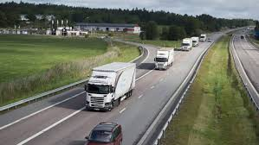
ROAD TRANSPORT

Slide 7
Advantages of road transport
It is easy and cheap to construct and maintain roads.
Roads can be brought to our door step. It can act as feeder to other modes of transport.
Roads can be built to cross high mountains like Himalayas.
Road can be built across forests and deserts. \
For the transportation of perishable goods, road transport is better than railways.

Slide 8
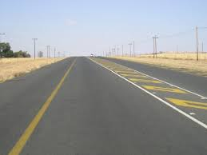
Types of roads on the basis of their strength and makeup and material used for construction
Surfaced (metalled) roads: They are made up of concrete, bitumen and tar. They are all weather roads.

Slide 9
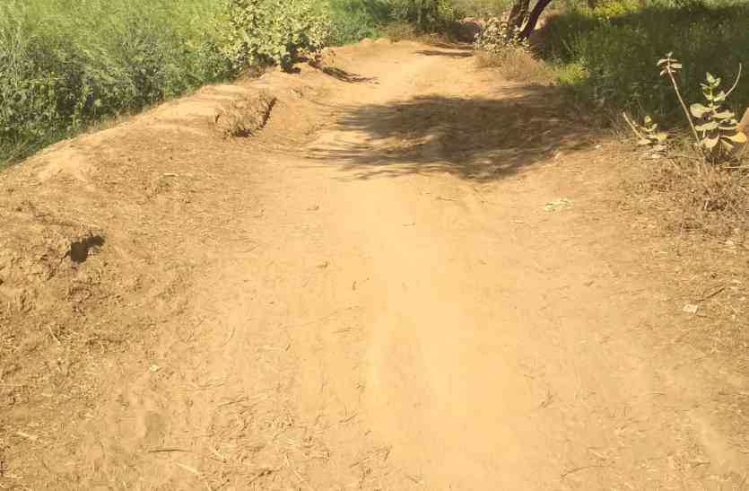
Unsurfaced (kuchcha) road: They are found in village areas. They are muddy roads. They are not useful during rainy season.

Slide 10
Roads
Border Roads
National Highways
State Highways District Roads
Express way National Highways

Slide 11
National Highways (NH): They are the roads which connect two or more states
They are our primary road system.
The Central Public Works Department constructs and maintains NHs.

Slide 12
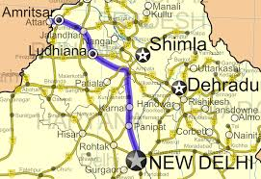
Shersha Suri Marg is National Highway No. 1

Slide 13
State Highways
Roads connecting a state capital with different district headquarters are known as State Highways.
These roads are constructed and maintained by the State Public Works Department (PWD)

Slide 14
District Roads:
These roads that connect the district headquarters with other places of the district.
These roads are maintained by the Zila Parishad.
Village roads: Small roads that connect village with towns are called village roads
They are constructed and maintained by village panchayat.
Under Pradhan Mantri Grameen Sadak Yojana funds are allotted for the village roads

Slide 15
BORDER ROADS

Slide 16
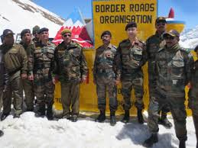
Border Roads Organisation established in 1960 constructs ands maintains Border Roads.

Slide 17
Border Roads
India has a very long land border which needs to be protected.
Our soldiers are guarding the border under harsh geographic and climatic conditions.
We need to supply food, arms and ammunition to soldiers.
For easy movement of soldiers during the time of war these roads are highly essential.
They are needed for organizing anti-terrorists operations and to prevent cross border terrorism.
So the border roads strengthen our defence system.

Slide 18
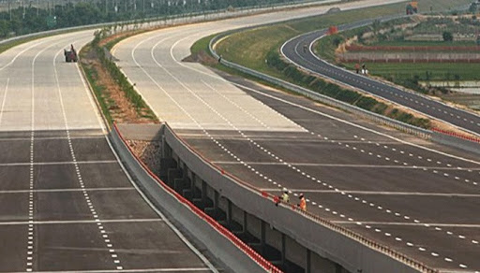
Golden Quadrilateral Super Highways
They are meant for fast traffic from one part of the country to another.
Most of them are built by private companies.

Slide 19
Express way National Highways are 4-6 lanes roads meant for fast traffic from one place of the country to another. These roads are named as:
Golden quadrilateral: It connects Delhi, Kolkata, Chennai and Mumbai.
North south and East west corridors: North south corridor connects Srinagar with Srinagar with Kanniyakumari.
East west corridor connects Silchar with Porbandar.
Roads connecting major ports with golden quadrilateral and corridors.

Slide 20
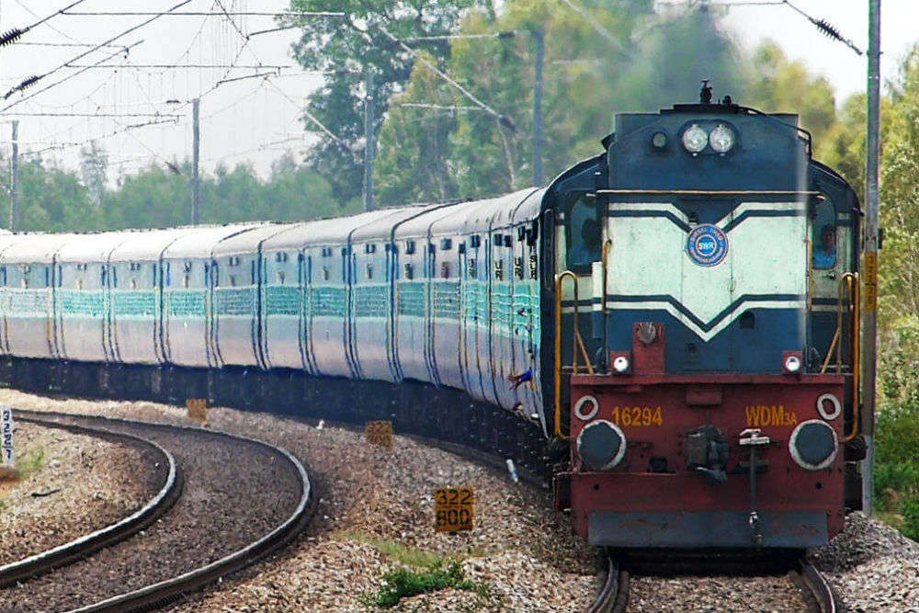
RAILWAYS

Slide 21
Railways connect different parts of the country and promote national integration.
Most of the long distance passenger traffic is carried by the railways. Railways provide comfortable journey to the passengers.
Railways are the largest public sector undertaking in India. It provides employment to 16 million people.
Railways carry heavy and bulky goods over long distance and help in the agricultural and industrial development of the country.

Slide 22
Distribution pattern of railway network
The distribution pattern of railway network is influenced by Physiographic, economic and administrative factors.

Slide 23
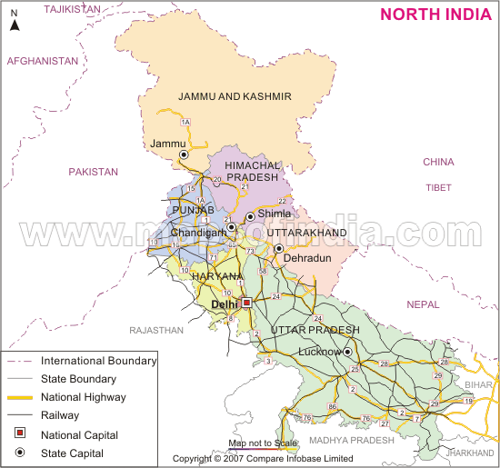
NORTHERN PLAIN

Slide 24
Northern plains have dense railway network because it is a densely populated, leveled land with a lot of agricultural and industrial activities.
There are large number of rivers. So, several bridges had to be constructed.

Slide 25
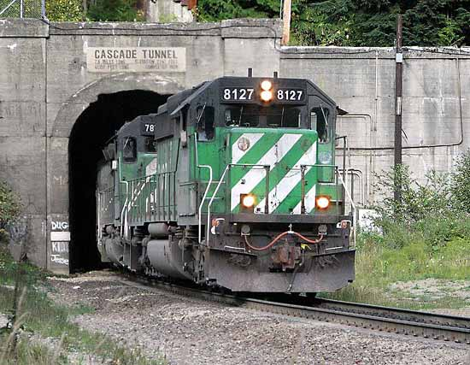
Peninsular Region
In the peninsular region, railway lines are laid through low hills, gaps or tunnels. Konkan Railway plays a major role in the economic development of this region. It is facing problems like landslides and sinking of tracks

Slide 26
Sandy plain of western Rajasthan, swamps of Gujarat, forested tracks of Madhya Pradesh, Chhattisgarh, Odisha and Jharkhand have less railway due to unfavourable geographic conditions.
Railway network is very less in the Himalayan region due to unfavourable factors like High Relief, Less Population and Less Economic activities.

Slide 27
Problems faced by the Indian railways.
Many passengers travel in train without tickets.
Some people pull the alarm chain unnecessarily. This cause delay of train.
Some people block the train as a part of their strike.
Some people steal or destroy the railway property.

Slide 28
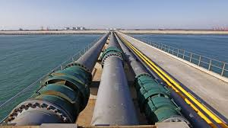
PIPELINE TRANSPORTATION

Slide 29
Advantages of Pipeline Transportation.
Pipeline transport network is a new arrival on the transportation map of India.
Pipeline transportation (P.T.) is faster than the other means of transportation.
It is cheap because the running coast is very less.
Transshipment loses can be avoided.
It enables the establishment of thermal power plants away from the coal fields and ports.

Slide 30
Important networks of pipeline transportation in India.
Pipeline from oil field in upper Assam to Kanpur.
Pipelines from Salaya in Gujarat to Jalandhar in Punjab.
Gas pipelines from Hazira in Gujarat to Jagdishpur in U.P. via Vijaipur in M.P. (HPJ pipeline).

Slide 33
Merits of water transport
Water ways are the cheapest means of transport.
They are suitable for carrying heavy and bulky goods.
They are fuel efficient.
They cause very less pollution.

Slide 34
WATER TRANSPORT
INLAND WATER WAYS MARINE TRANSPORT

Slide 35
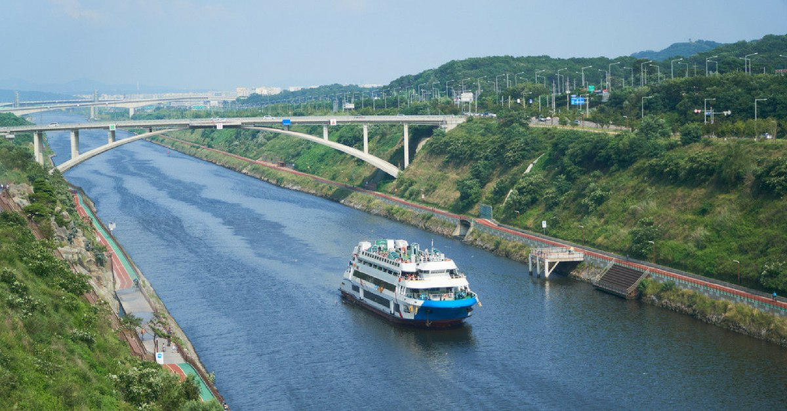
INLAND WATER WAYS

Slide 36
India has inland navigation waterways of 14,500 km in length.
Out of these only 5685 km are navigable by mechanised vessels.

Slide 37
NATIONAL WATER WAYS
National Water Way No. 1: The Ganga river between Allahabad and Haldia.
National Water Way No. 2: The Brahmaputra river between Sadiya and Dhubri .
National Water Way No. 3: The West-Coast Canal in Kerala (Kottapurma-Kollam, Udyogamandal and Champakkara canals)

Slide 38
National Water Way No. 4: Parts of Godavari and Krishna rivers along with Kakinada Puducherry canals.
National Water Way No. 5: Parts of river Brahmani along with Matai river, delta channels of Mahanadi and Brahmani rivers and East Coast Canal.

Slide 39
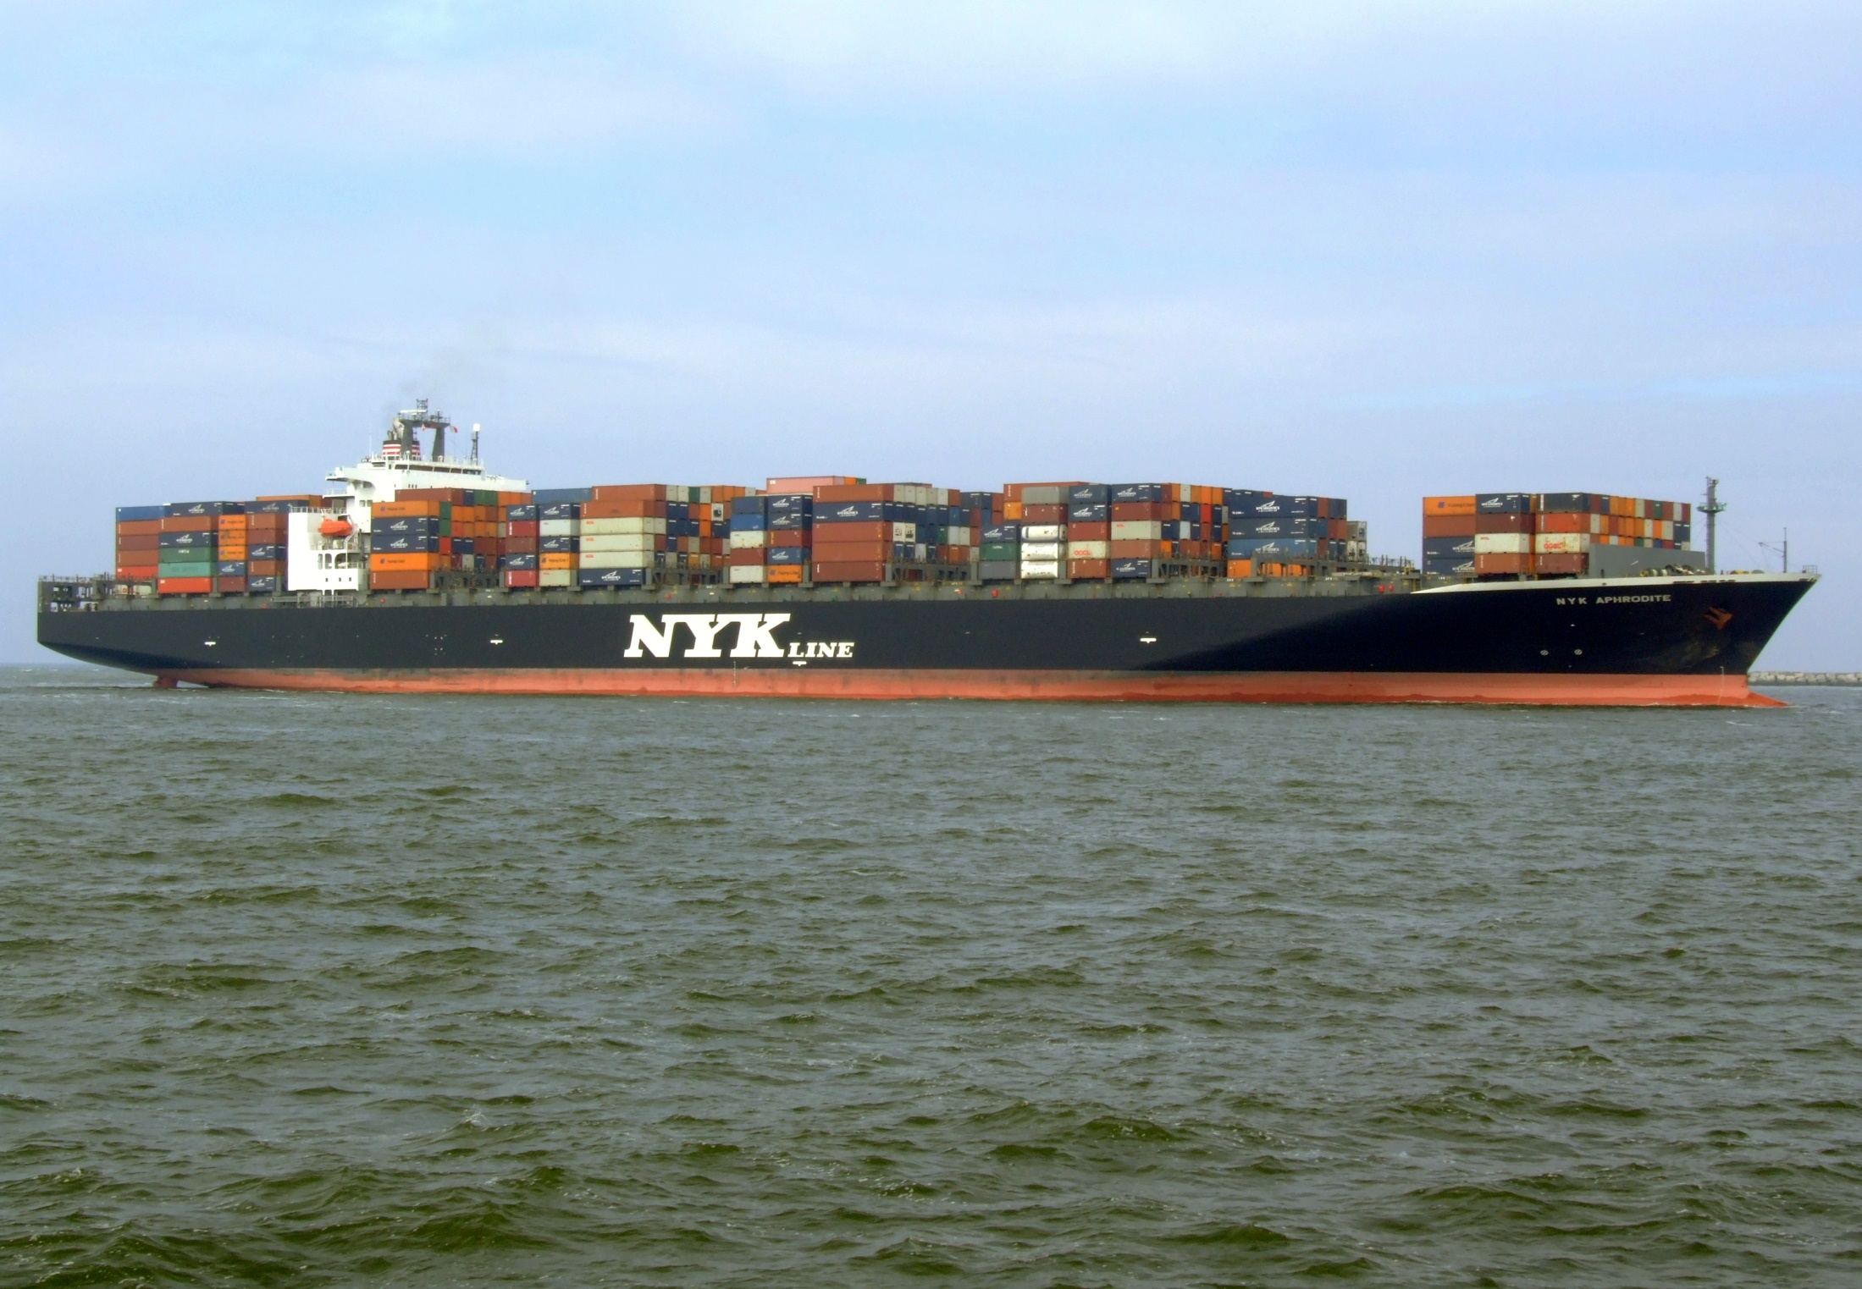
MARINE TRANSPORT

Slide 40
India has a long coastline of 7,516.6 km
There are 12 major and 200 minor and intermediate ports.
They handle 95 per cent of India’s foreign trade.

Slide 42
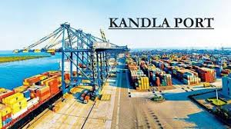
Kandla Port(Deendayal Port):
It is the first port developed after Independence.
The burden on Mumbai port increased due to the loss of Karachi port to Pakistan.
To reduce the burden of Mumbai port Kandla port was developed in Kuchchh in Gujarat.
It is a tidal port.

Slide 43
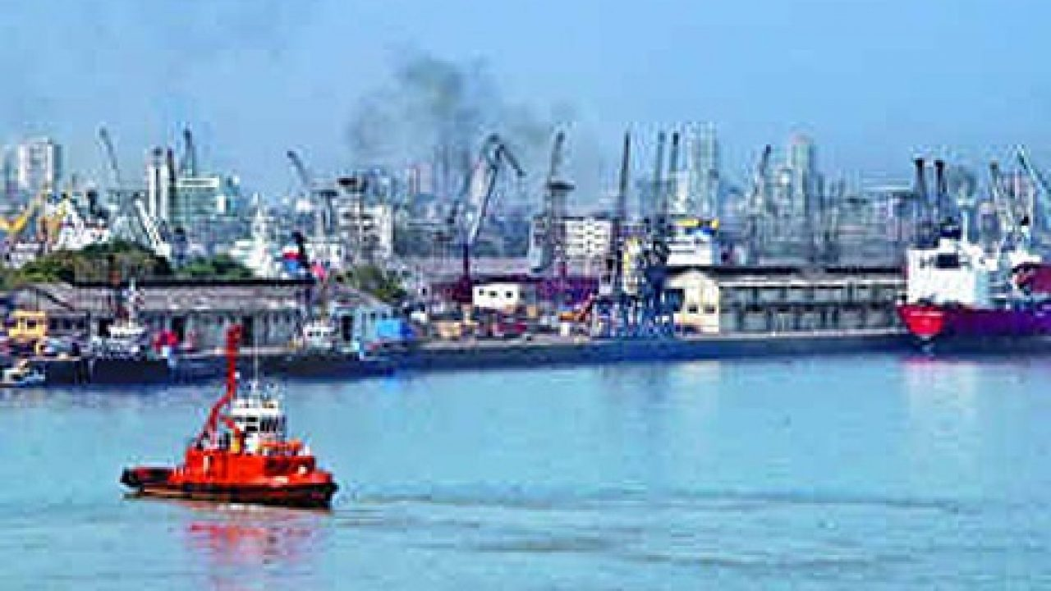
MUMBAI PORT
It is the biggest sea port in India with a natural well sheltered harbour.

Slide 44
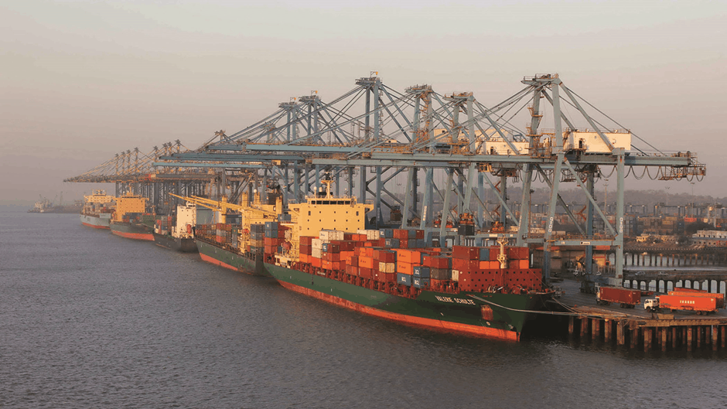
JAWAHARLAL NEHRU PORT
It was developed near to Mumbai port in order to reduce the burden of Mumbai port.

Slide 45
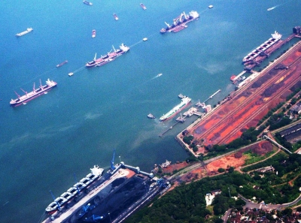
Marmagao Port
It is an iron ore exporting port located in Goa. 50% of India’s iron exports are from this port.

Slide 46
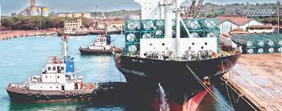
New Mangalore Port
It is located in Karnataka. Iron ore from Kudremukh mines are exported from this port.

Slide 47
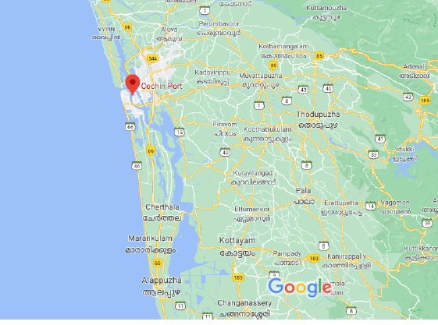
KOCHI PORT
Kochi port, in Kerala, is located at the entrance of a lagoon. It is a natural harbour.

Slide 48
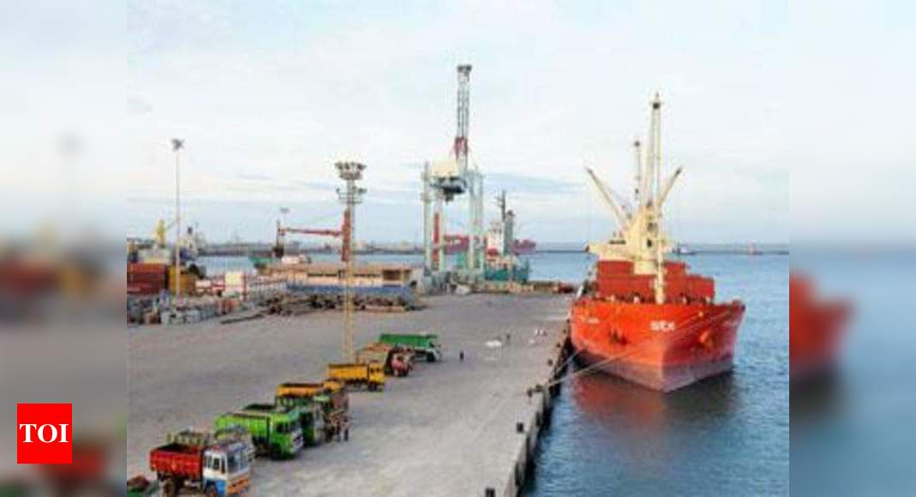
Tuticorin Port
It is located in Tamil Nadu. It is a natural harbour. Cargo to Srilanka and Maldives are handled by this port.

Slide 49
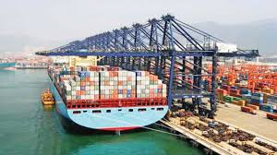
CHENNAI PORT
It is the second largest seaport of India.
It is the oldest artificial harbour in India.

Slide 50
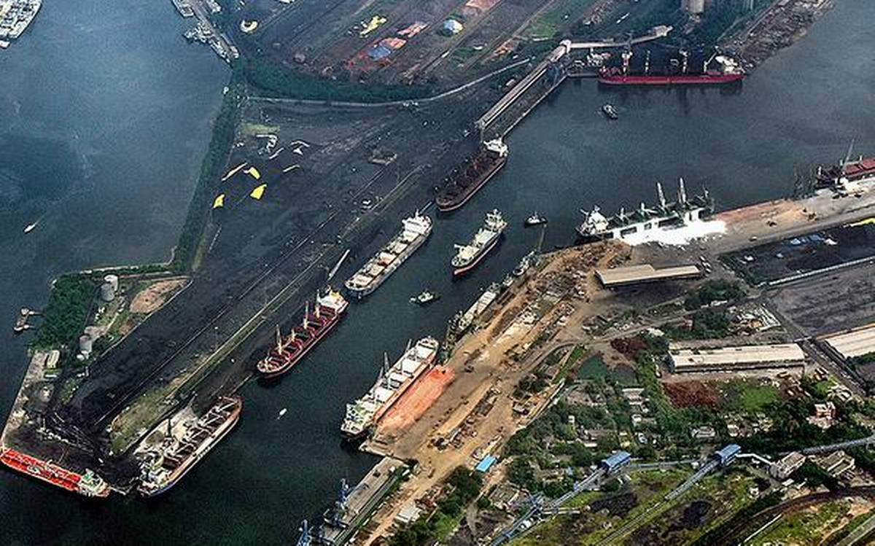
Vishakhapatnam Port
It is the deepest landlocked and well-protected port. It is a major iron ore exporting port.

Slide 51
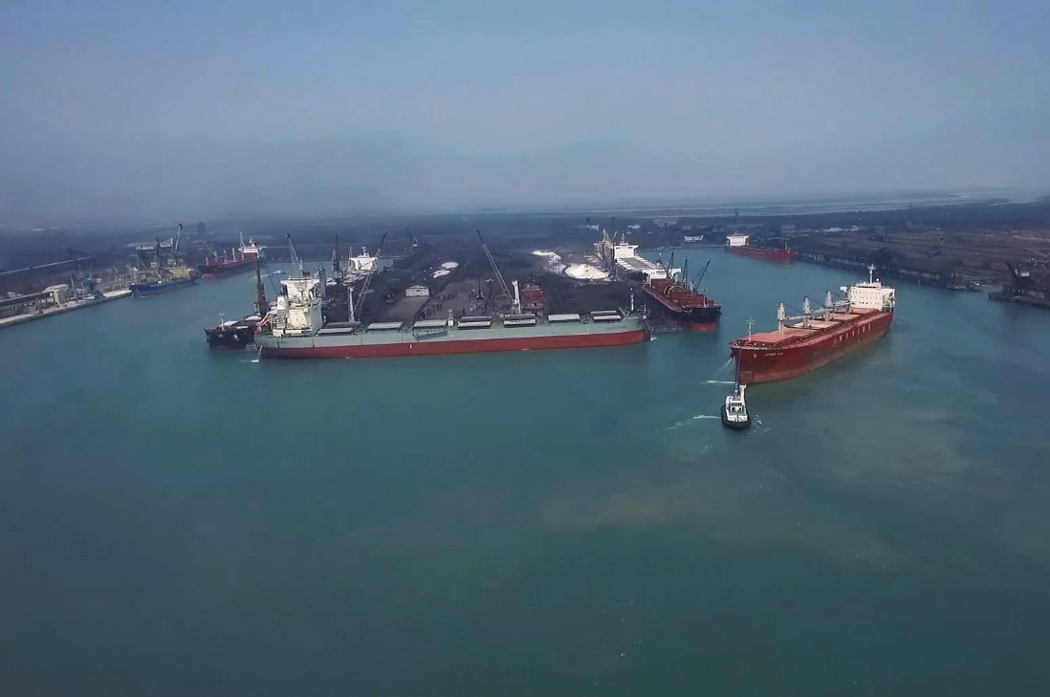
Paradip Port
It is an iron ore exporting port located in Odisha.

Slide 52
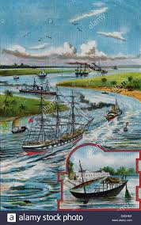
Kolkata Port
It is an inland riverine port. It is located on river Hoogli. Constant dredging has to be done to remove silt. It is a tidal port.

Slide 53
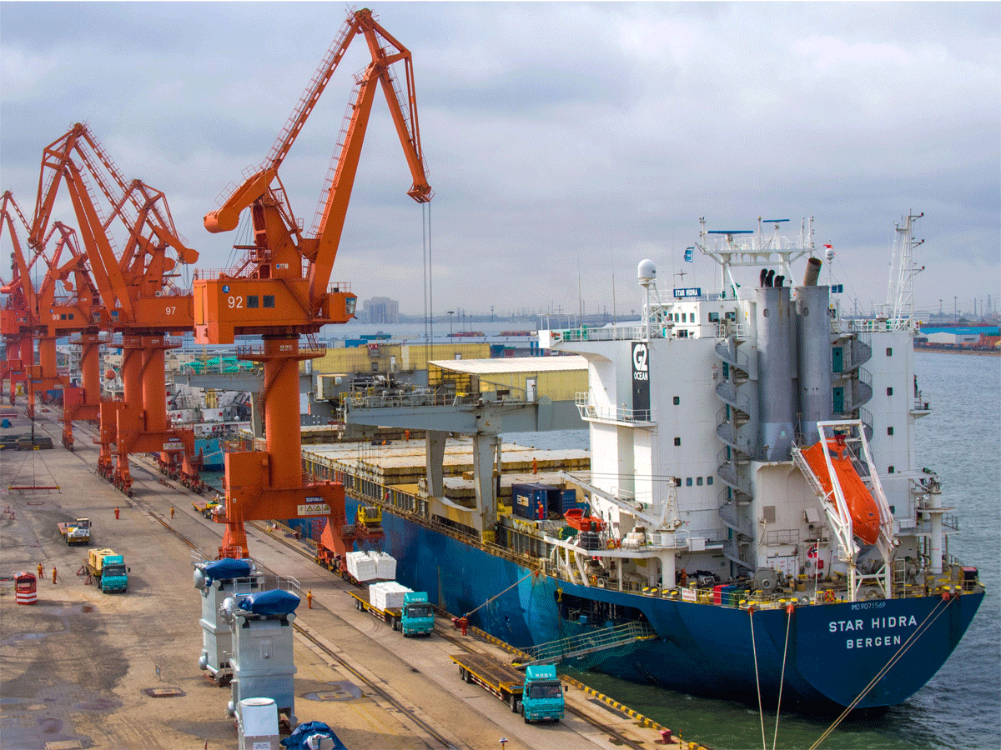
HALDIA PORT
It is developed near to Kolkata port in order to reduce the burden on Kolkata Port.

Slide 54
AIR WAYS

Slide 55
Importance of air transport
Airways provide fastest means of transport.
Air transport is the most comfortable one.
Airways are the best means of transport in remote, inaccessible and hostile area.
During natural and human made calamities like flood, earthquakes and war air transport play an important role.

Slide 56
Importance of Airways in North eastern parts of the country.
North eastern parts of India are highly mountainous.
They are thickly forested.
There are many flooding rivers and international boundaries.
So construction of roads and railways is difficult and expensive.
Moreover rail and road transports are expensive and time consuming.
So air transport is very important in this area.

Slide 57
The air transport was nationalised in 1953.
Air India provides domestic and international air services.
Pawanhans Helicopters Ltd. provides helicopter services to Oil and Natural Gas Corporation in its off-shore operations
It also provides services to north-eastern states and the interior parts of Jammu and Kashmir, Himachal Pradesh and Uttarakhand.

Slide 58
COMMUNICATION

Slide 59
Exchange of information by speaking, writing, or using some other medium is called communication.
Communication
Personal Communication Mass Communication

Slide 60
Personal Communication
Personal Communications include private letters, emails, personal interviews, telephone conversations, and similar resources.

Slide 61
POSTAL SERVICES
The Indian postal network is the largest in the world.
Post offices are set up in almost all villages, towns and cities.
First Class Mail: Cards and envelopes are called first class mail. They are air lifted between places.
Second class Mail: book packets, registered newspapers and periodicals are called Second class mail. They are transported by land and water transport.

Slide 63
TELECOM NETWORK
India has one of the largest telecom networks in Asia.
More than two-thirds of the villages in India are covered by Subscriber Trunk Dialing (STD) telephone facility.
There is a uniform rate of STD facilities all over India.

Slide 64
MASS COMMUNICATION

Slide 65
MASS COMMUNICATION
It includes radio, television, newspapers, magazines, books and films.
Akashavani is national radio network
Doordarshan is national television channel. It is one of the largest terrestrial networks in the world.
Newspapers are published in about 100 languages.
Largest number of newspapers published in Hindi, followed by English and Urdu.
India is the largest producer of feature films in the world. The Central Board of Film Certification certify both Indian and foreign films.

Slide 66
IMPORTANCE OF MASS COMMUNICATION
Means of mass communication like radio, TV and news papers make the people aware of various national programmes and policies.
They help the people to know the various problems faced by the country.
They provide healthy entertainment to people and also create public opinion.
They are now being used for spreading education among the masses.

Slide 68
Trade between two countries is called international trade.
Export and Import are the two components of foreign trade.
When a country buys goods from another country, it is called import.
When a country sells goods to another country, it is called export.

Slide 69
The balance of trade of a country is the difference between its export and import.
When the value of export is more than the value of imports, it is called a favourable balance of trade.
When the value of imports is more than the value of exports, it is called unfavourable balance of trade.

Slide 70
Examine the importance of Foreign Trade.
Foreign trade contributes to the economic progress of a Nation. The Nation can get foreign goods and foreign technology.
The Nation can earn valuable foreign currency by exporting its goods. This adds to the richness of the country.
The Nation can sell out its surplus goods in the other countries and this helps in the industrial and agricultural development.

Slide 71
Export of services based on Information Technology creates a lot of job opportunities to the educated people.
The Nation can overcome food shortage by importing food materials. The starvation deaths can be avoided.

Slide 72
India imports petroleum products, gems and jewellery, chemicals, base metals, electronic items, machinery, agriculture and allied products.
India is a software giant and earns a lot of foreign exchange by exporting information technology.

Slide 73
TOURISM

Slide 74
India has great potential to develop heritage tourism, cultural tourism, eco tourism and medical tourism. Temple towns of south India and the cultural heritage of Rajasthan attract many tourists.
It provides employment to a large number of people. 15 million people are directly engaged in tourism industry.

Slide 75
It supports the local handicrafts. Tourists buy the handicrafts.
It supports local art forms. Many foreign tourists visit the country to learn our classical dances.
The country can earn a lot of foreign currency through tourism.

Slide 76
THANK YOU

